Slide 1
Internship 2022
Progress report on E-tricycle Name: Njenga Emmanuel

Slide 2
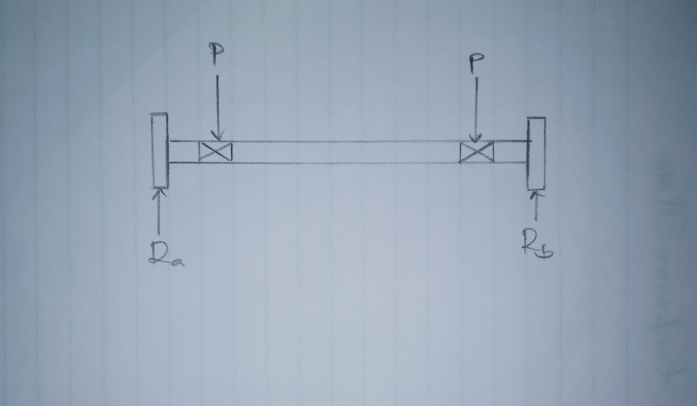

Tasks completed last week
[#20]Design of shaft
At 600rpm for the 1200W ${, T}_{max}$=19.10Nm
Using the maximum shear stress theory (Guest’s theory)
$\sqrt{M^{2}+T^{2}}$=$\frac{π}{16}×τ_{max} ×d^{3}$
Diameter= 15.62mm

Slide 3
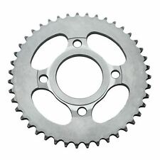
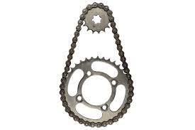

[#21]Chain drive design
Design for the sprockets
Speed ratio=3.5
The larger sprocket=47T
Smaller sprocket = 15T
Design for the chain
D=180mm
d=70mm
Center distance ,x = 170mm
Chain length=$π\left(R+r\right)+2x+{\left(\frac{R−r}{X}\right)}^{2}$
L=760mm

Slide 4
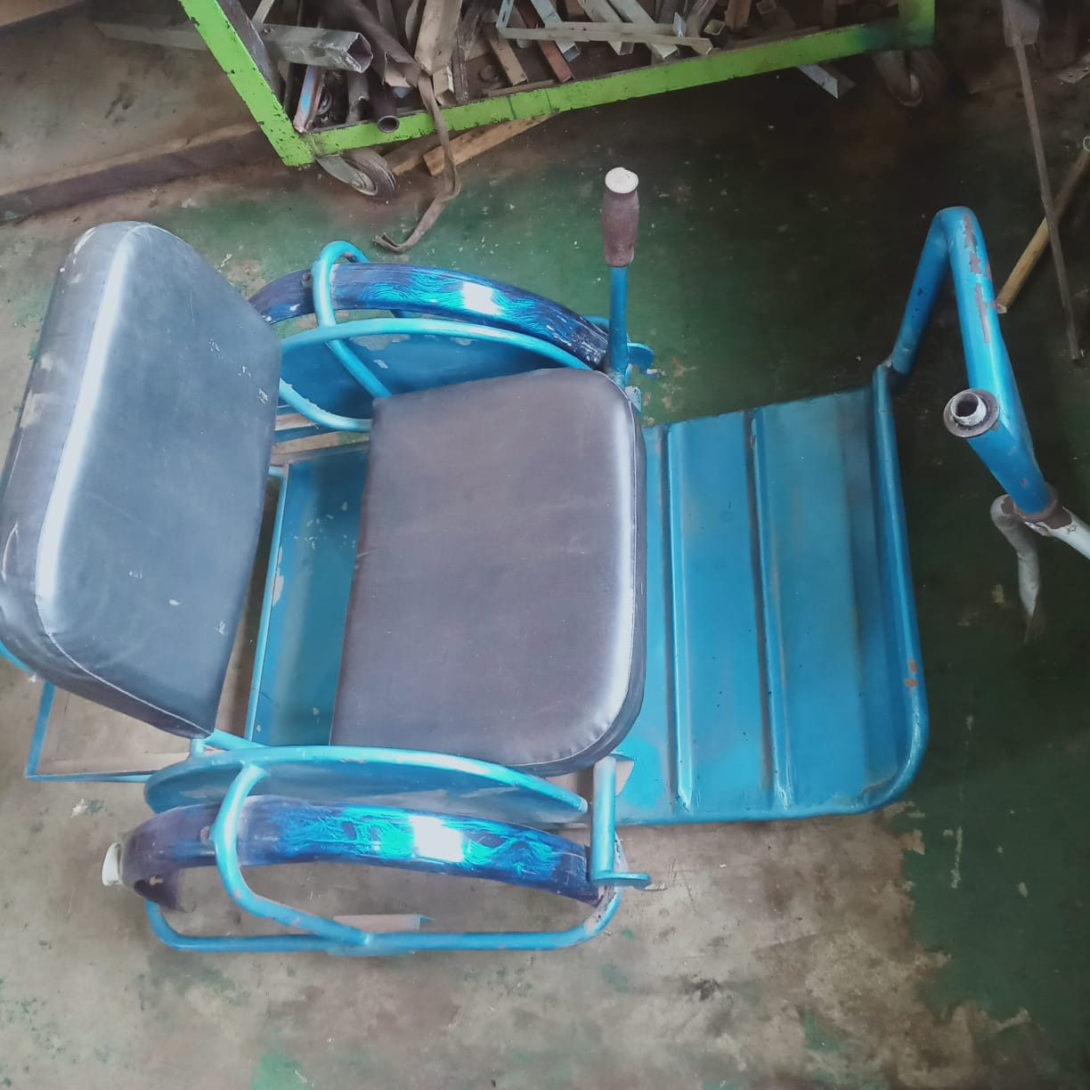
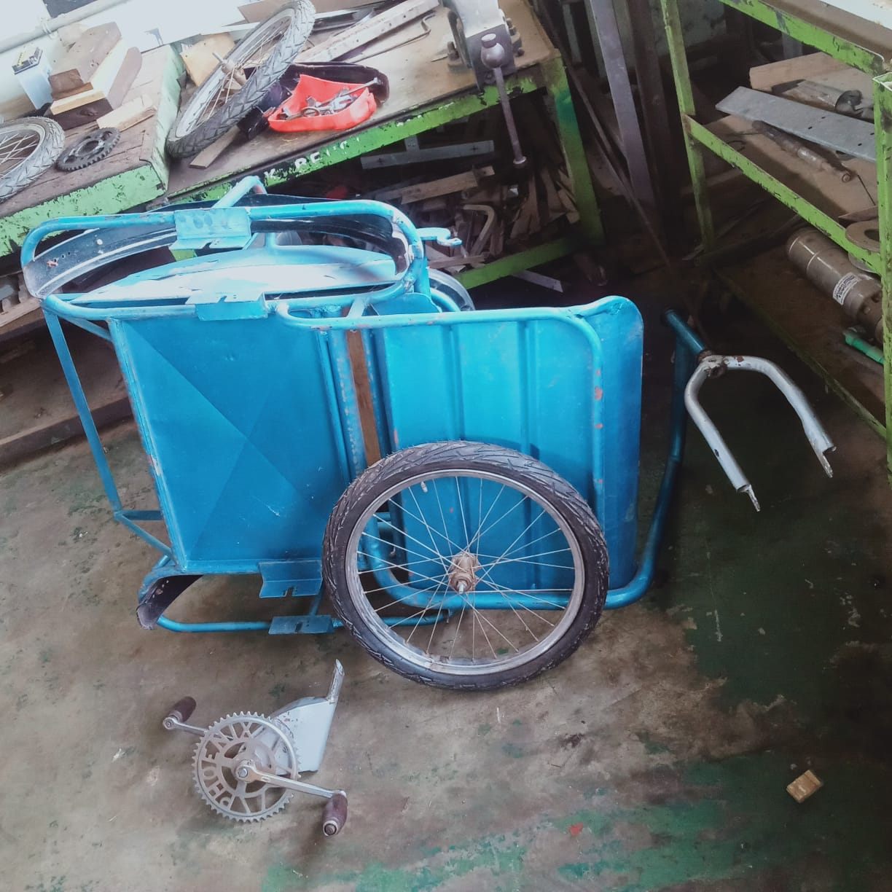
Disassembly of the tricycle

Slide 5
Tasks in this week
[#31]Fabrication and assembly of the tricycle
[#32]Acquistion of parts
[#33]Calculation of power requirements for the shujaa tractor

Slide 6
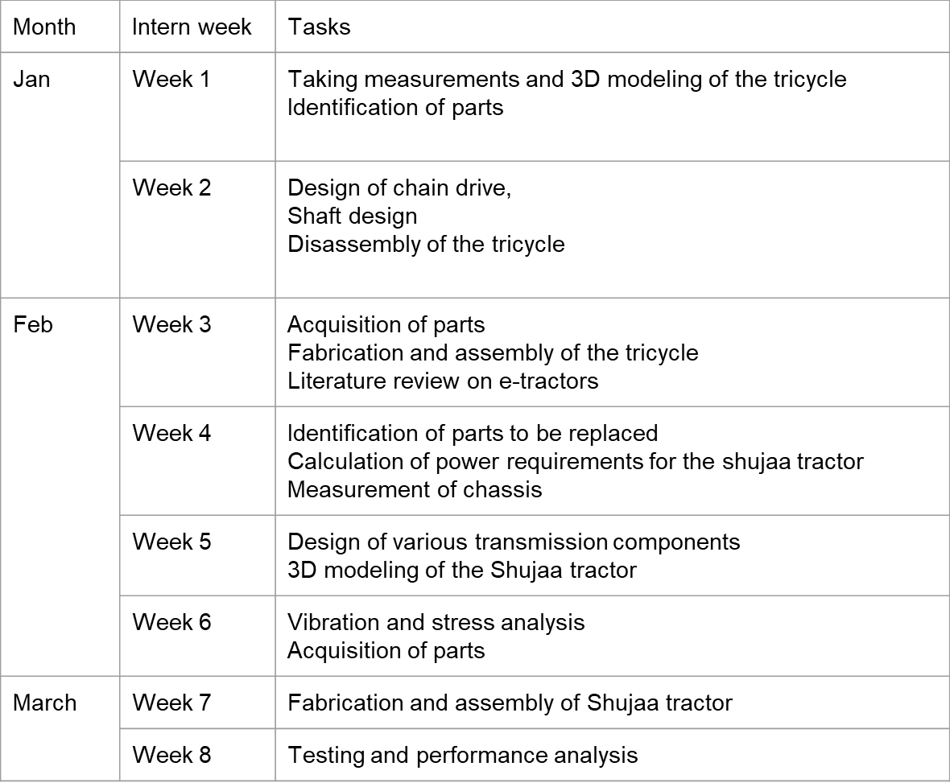
Timeline

